Slide 1

WATER LEVEL SENSOR
Course code:MLA0104
Course name :Artificial Intelligence for Expert Systems
Guided by: Dr . M.Prakash
Presented By:
K . Naga Preetham (192525242)

Slide 2


Introduction
A Water Level Sensor is a device used to detect or measure the amount or height of water present in a tank, container, reservoir, sump, or other water-storage system
The sensor converts the physical water-level condition into an electrical signal. This signal can be processed by a microcontroller such as Arduino, ESP32, or a PLC.
Water level sensors are commonly used for:
Detecting low and high water levels
Preventing tank overflow
Avoiding water wastage
Smart water-management systems
Modern water-level monitoring systems can combine sensors + IoT + Artificial Intelligence/Machine Learning to make the system more intelligent.

Slide 3
Why Water Level Sensing is Important
Water level monitoring is important because water is a limited and valuable resource.
Main benefits
1. Prevents Overflow
When a tank becomes full, the sensor can detect the high level and switch OFF the water pump.
2. Prevents Dry Running
When the water level becomes too low, the system can stop the pump to prevent damage.
3. Reduces Water Wastage
Automatic monitoring prevents unnecessary overflow and helps control water consumption.
4. Automatic Control
The sensor can be connected to a controller and relay to automatically turn pumps ON or OFF.
5. Remote Monitoring
With IoT technology, water-level information can be sent to a mobile application or cloud dashboard.
6. Smart Water Management
Historical sensor data can be analyzed using AI/ML to identify abnormal consumption and predict future water levels.

Slide 4
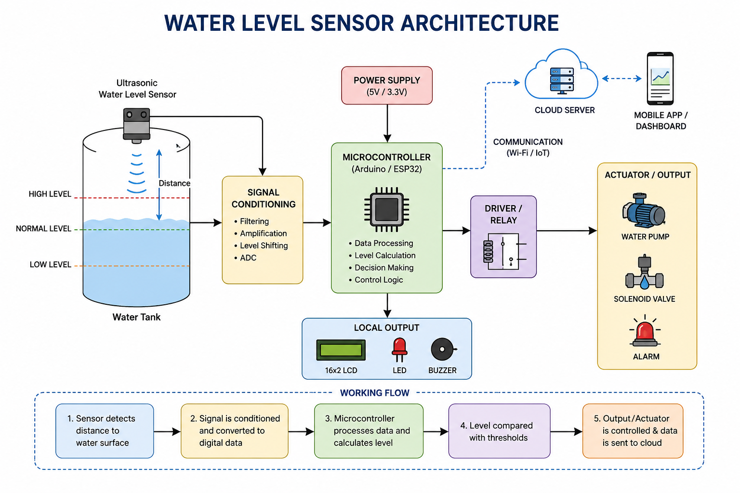
Water Level Sensor Architecture

Slide 5
Working Principle
The working principle depends on the type of water-level sensor.
The general process is:
Step 1 – Detection:
The sensor detects the water level or distance between the sensor and water surface.
Step 2 – Signal Generation:
The physical change is converted into an electrical signal.
Step 3 – Signal Processing:
The controller receives the signal and processes it.
Step 4 – Level Calculation:
The system determines the water level from the sensor reading.
Step 5 – Decision:
The measured level is compared with predefined limits.
For example:
Low level → Pump ON
High level → Pump OFF
Critical level → Alert
Step 6 – Output:
The result can be displayed locally or transmitted to a remote monitoring system.

Slide 6
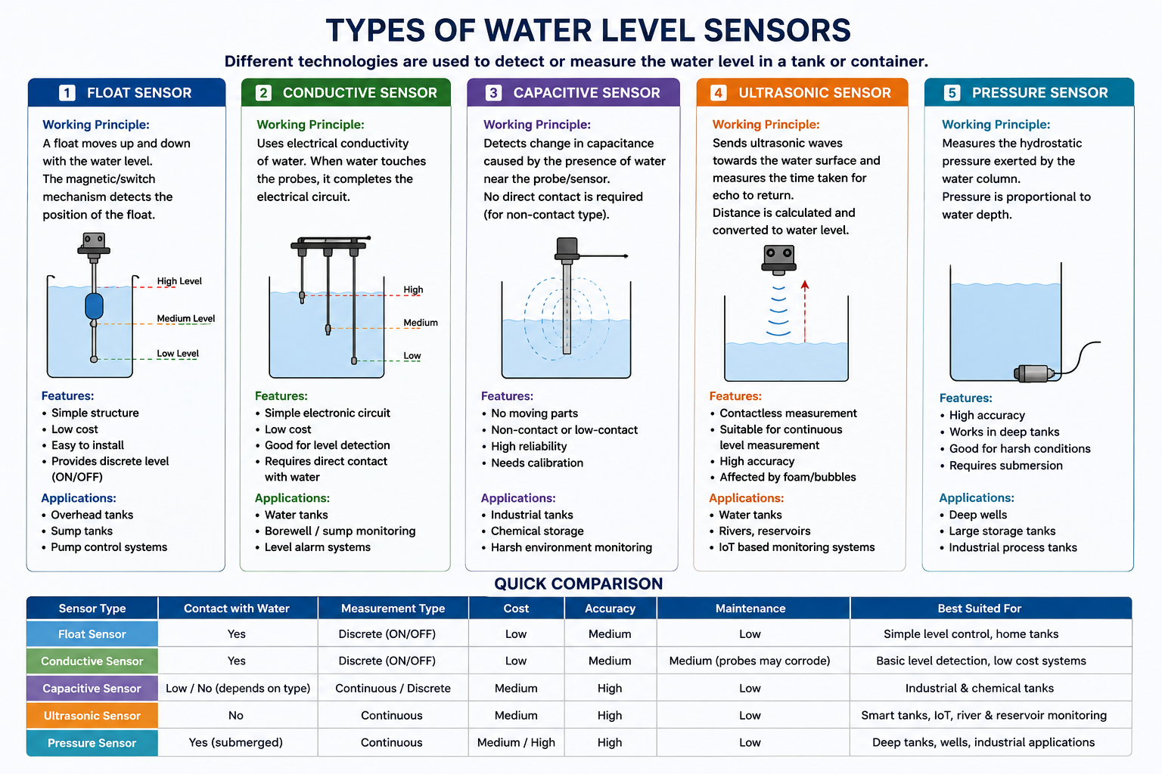
Proposed System

Slide 7
AI/ML Integration with Water Level Sensor
AI/ML analyzes sensor data collected over time.
Prediction: Predicts future water levels and tank filling/emptying time.
Anomaly Detection: Detects unusual level changes caused by leakage or abnormal usage.
Fault Detection: Identifies abnormal sensor readings.
Smart Pump Control: Helps decide when to turn the pump ON or OFF.
Overall: AI changes the system from simple monitoring to prediction and intelligent decision-making.
Simple Flow:
Water Level Sensor → Data Collection → AI/ML Model → Prediction/Anomaly Detection → Smart Decision

Slide 8
Applications
Water-level sensors are used in many areas.
1. Smart Homes
Used for monitoring overhead tanks and controlling household water pumps.
2. Agriculture
Used to monitor water storage tanks and irrigation systems.
3. Industries
Used for monitoring water and liquid levels in industrial tanks.
4. Reservoirs
Used to monitor water storage levels.
5. Smart Buildings
Water-level information can be integrated into building-management systems.
6. IoT Water Monitoring
Sensors can send real-time readings to cloud platforms.

Slide 9
Comparison with Existing Technologies
Parameter | Float Sensor | Conductive Sensor | Capacitive Sensor | Ultrasonic Sensor | Pressure Sensor
Working Principle | Buoyancy | Electrical conductivity | Change in capacitance | Ultrasonic echo | Hydrostatic pressure
Water Contact | Yes | Yes | Low/No* | No | Yes
Measurement | Point level | Point level | Point/Continuous | Continuous | Continuous
Cost | Low | Very Low | Medium | Medium | Medium
Accuracy | Medium | Medium | High | High | High
Maintenance | Medium | Medium | Low | Low | Low
Moving Parts | Yes | No | No | No | No
Main Advantage | Simple & cheap | Easy level detection | No moving parts | Contactless measurement | Reliable depth measurement
Main Limitation | Mechanical wear | Requires conductive water | Needs calibration | Foam/condensation can affect readings | Sensor is submerged
Best Application | Home tanks | Basic water-level alarms | Industrial tanks | Smart/IoT tanks | Wells & large tanks

Slide 10
Challenges
Water-level sensors can face several practical problems.
1. Sensor Calibration
Incorrect calibration can produce inaccurate readings.
2. Environmental Noise
Electrical or physical noise can affect sensor measurements.
3. Foam and Bubbles
For ultrasonic sensors, foam or bubbles on the water surface can affect the reflected signal.
4. Condensation
Moisture or condensation near the sensor can affect measurements.
5. Corrosion
Contact-based sensors may experience corrosion over time.
6. Power Consumption
Battery-powered IoT systems must be designed for low power consumption.
7. Communication Problems
Wireless sensors can lose connectivity in environments with weak signals.
8. Sensor Failure
A faulty sensor can produce abnormal readings, so fault detection is important.

Slide 11
Future Trends of Water Level Sensors
AI & Machine Learning: Predict future water levels and detect abnormal patterns.
IoT Connectivity: Enable real-time monitoring through cloud and mobile dashboards.
Edge AI: Process sensor data locally for faster decisions, even with limited connectivity.
Sensor Fusion: Combine water-level, flow, pressure, rainfall, and other sensor data for better accuracy.
Digital Twins: Create virtual models of tanks and water systems for monitoring and prediction.
Low-Power Sensors: Use energy-efficient sensors and wireless technologies for long-term operation.
Autonomous Control: Future systems can automatically control pumps and valves based on sensor data and AI predictions.

Slide 12
Conclusion
Water level sensors provide accurate and automatic water-level monitoring.
Different sensors such as float, conductive, capacitive, ultrasonic, and pressure sensors are available.
Ultrasonic sensors are useful for contactless and continuous level measurement.
Integration with IoT and AI/ML enables prediction, anomaly detection, and smart control.
Future systems will become more intelligent, connected, low-power, and predictive.
Water-level sensing can therefore play an important role in smart and sustainable water management.

Slide 13


